Slide 1
Lecture 10
Chapter 7
Input/Output

Slide 2
Input/Output Problems
Each I/O module interfaces to the system bus or central switch and controls one or more peripheral devices
I/O module is not simply a set of mechanical connectors that wire a device into a system bus. I/O contains “intelligence” : it contains logic for performing a communication between the peripheral and the bus
Wide variety of peripherals, with various methods of operation. It would be impractical to incorporate the necessary logic within a processor to control a range of devices

Slide 3
Input/Output Problems (2)
Data transfer rate of peripherals is often much slower than that of the memory or processor. Thus, impractical to use high speed system bus to communicate directly
On the other hand, the data transfer rate of some peripherals is faster than that of the memory or processor. Again, the mismatch lead to inefficiencies
Peripherals often use different data formats and word lengths than the computer
Thus, I/O modules is needed

Slide 4
Input/Output Module
Interface to CPU and Memory, via the system bus or central switch
Interface to one or more peripheral devices by tailored data links

Slide 5
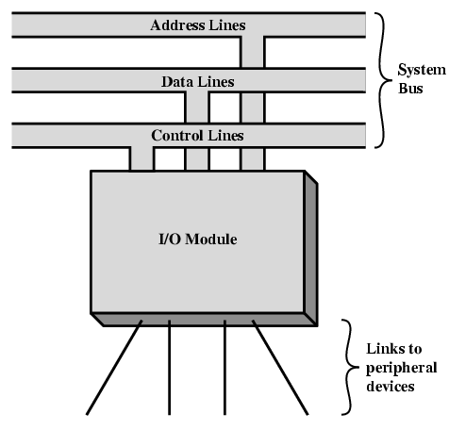
Generic Model of I/O Module

Slide 6
External Devices
We can classify the external devices into 3 categories:
Human readable: suitable for communicating with computer user
  Screen(VDT-video display terminal), printer, keyboard
Machine readable: suitable for communicating with equipment
  Magnetic disk and tape systems, sensors
  Monitoring and control
Communication: suitable for communicating with remote devices
  Modem, terminal, machine readable device, another PC
  Network Interface Card (NIC)

Slide 7
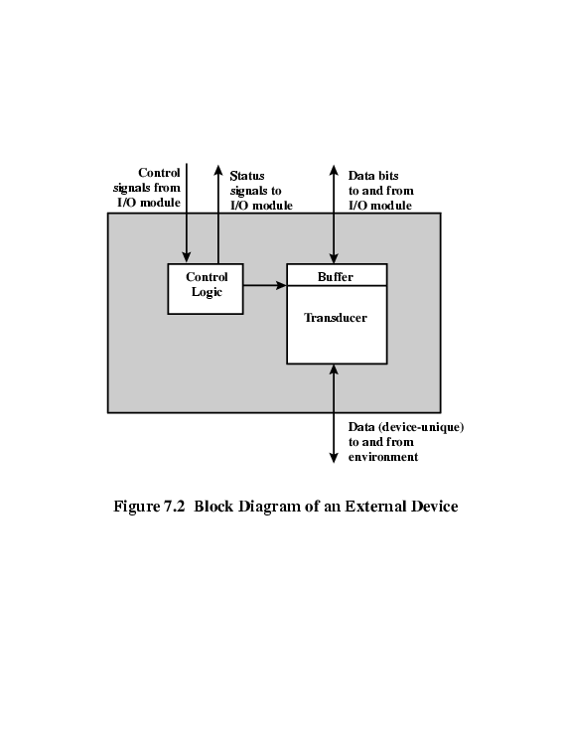
External Device Block Diagram

Slide 8
External Device Block
Control Signals determine the function that the device will perform, such as send data to the I/O Module (Input or READ), accept data from the I/O Module, report status, or perform some control function particular to the device (e.g., position a disk head)
Data are in the form of a set of bits to be sent to or received from the I/O module
Status signals indicate the state of the device (e.g., READY/NOT READY)
Control logic associated with the device, controls the device’s operation in response to direction from the I/O module
Transducer converts data from electrical to other forms of energy during output an from other forms to electrical during input

Slide 9
External Device Block (2)
Buffer is associated with the transducer to temporary hold data being transferred between the I/O module and the external environment
The size of this buffer is commonly of 8 to 16 bits
Disk Drive
In a fixed-head disk, the transducer is capable of converting between the magnetic patterns on the moving disk surface and bits in the device’s buffer
While in a moving-head disk must be able to cause the disk arm to move radially in and out across the disk’s surface

Slide 10
Keyboard/Monitor
When user depresses a key, this generates an electronic signal that is interpreted by the transducer in the keyboard and translated into bit pattern of the corresponding IRA code.
The bit pattern is then transmitted to the I/O module in the computer and stored as IRA code (may also be displayed on the monitor).
On output, IRA code characters are transmitted to an external device from the I/O module
The transducer at the device interprets this code and sends the required electronic signals to display the character.

Slide 11
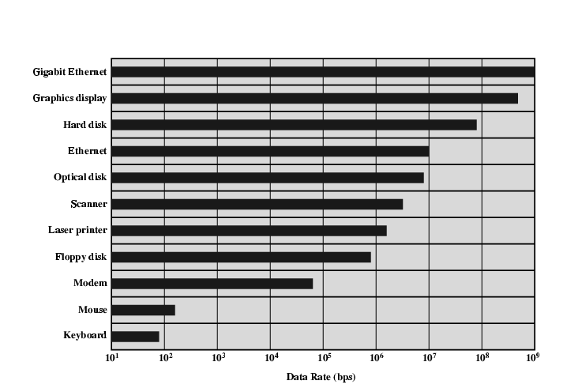
Typical I/O Data Rates

Slide 12
I/O Module Function
The major functions or requirements for an I/O module are:
Control & Timing
CPU Communication
Device Communication
Data Buffering
Error Detection
The processor may communicate with one or more external devices, depending on the program’s need for I/O. The internal resources, such as main memory and system bus, must be shared among a number of activities, including data I/O
Thus, I/O function includes a control and timing requirement, to control the flow of traffic between internal resources and external devices

Slide 13
I/O Steps
The transfer of data from an external device to the processor may involve the following steps:
The CPU interrogates the I/O module to check the status of attached device.
I/O module returns the device status
If ready, CPU requests data transfer by means of a command to the I/O module
I/O module gets data from device
I/O module transfers data to CPU
Variations for output, DMA, etc.

Slide 14
I/O module communicate with the processor and with the external device
Processor and I/O module communication
  Command decoding: I/O module accepts commands from the processor sent as signals on the control bus.
  Data exchange between the processor and I/O module over the data bus.
  Status reporting: I/O module reports the status of external device
  Address recognition: I/O module must recognize the unique address for each device it controls.
I/O module and Device communication
  Commands
  Status information
  Data

Slide 15
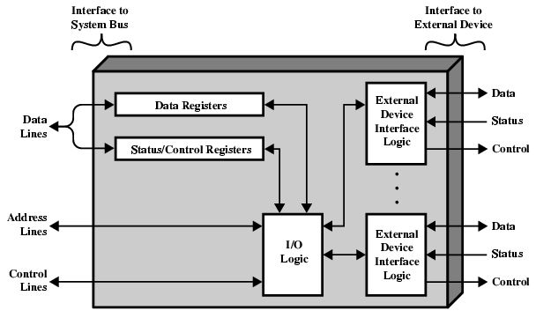
I/O Module Diagram
1
2, may act as control register, to accept detailed ctrl. info from CPU
CPU issues
commands
Logic interacts with the processor

Slide 16
I/O Module Decisions
Hide or reveal device properties to CPU
Support multiple or single device
Control device functions or leave for CPU
Also O/S decisions
  e.g. Unix treats everything it can as a file
I/O module usually referred as I/O Channel or I/O Processor
I/O module quite primitive and required detailed control is referred as I/O controller or device controller

Slide 17
Input Output Techniques
Programmed I/O: data are exchanged between the processor and the I/O module. The processor executes a program that gives it direct control of the I/O operation. When the processor issues a command to the I/O module, it must wait until the I/O operation is complete. Thus, if the processor is faster than the I/O module, this is wasteful of processor time.
Interrupt driven I/O: the processor issues an I/O command, continues to execute other instructions, and is interrupted by the I/O module when the work is completed.
Direct Memory Access (DMA): the I/O module and main memory exchange data directly, without the involvement of the CPU.

Slide 18
Input Output Techniques
 | No Interrupts | Use of Interrupts
I/O-to-memory transfer through processor | Programmed I/O | Interrupt I/O
Direct I/O-to-memory transfer |  | Direct Memory Access (DMA)

Slide 19
Programmed I/O
CPU has direct control over I/O
  Sensing status
  Read/write commands
  Transferring data
CPU waits for I/O module to complete operation
Wastes CPU time

Slide 20
Programmed I/O - detail
CPU requests I/O operation
I/O module performs operation
I/O module sets status bits
CPU checks status bits periodically
I/O module does not inform CPU directly
I/O module does not interrupt CPU
CPU may wait or come back later

Slide 21
I/O Commands
CPU issues address
  Identifies module (& device if >1 per module)
CPU issues command
  Control - telling module what to do
    e.g. spin up disk
  Test - check status
    e.g. Power? Error? Available for use ?
  Read/Write
    Module transfers data via buffer from/to device

Slide 22
Addressing I/O Devices
Under programmed I/O data transfer is very like memory access (CPU viewpoint): close correspondence between I/O-related instructions that the processor fetches from the memory and I/O commands that the processor issues to an I/O module to execute the instructions. That is, the instructions are easily mapped into I/O commands.
Each device given unique identifier
CPU commands contain identifier (address)

Slide 23
I/O Mapping
Memory mapped I/O
  Devices and memory share an address space, e.g., with 10 address lines, a combined total of 2¹⁰=1024 memory locations and I/O addresses can be supported, in any combination
  I/O looks just like memory read/write
  No special commands for I/O
    Large selection of memory access commands available
Isolated I/O
  Separate address spaces, e.g., with 10 address lines, a combined total of 2¹⁰ - 1024 memory locations and 1024 I/O addresses can be supported, in any combination
  Need I/O or memory select lines
  Special commands for I/O
    Limited set

Slide 24
Interrupt-Driven I/O
Overcomes CPU waiting
No repeated CPU checking of device
I/O module interrupts when ready

Slide 25
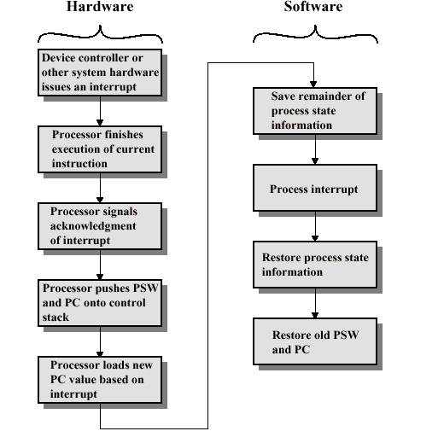
Simple Interrupt Processing

Slide 26
Interrupt Driven I/O
Basic Operation
CPU issues read command to I/O module
I/O module gets data from peripheral while CPU does other work
When data are in the I/O module’s data register, the module interrupts CPU
CPU requests data
I/O module transfers data

Slide 27
CPU Viewpoint
Issue read command
Do other work (e.g. processor may be working on several different programs)
Check for interrupt at end of each instruction cycle
If interrupted:-
  Save context (program counter, processor registers)
  Process interrupt
    Fetch data from I/O module & store in memory
Processor then restores the context of the program it was working on and resumes execution.

Slide 28
Design Issues
How do you identify the module issuing the interrupt?
How do you deal with multiple interrupts?
  i.e. an interrupt handler being interrupted

Slide 29
Identifying Interrupting Module (1)
Different line for each module
  PC
  Limits number of devices
Software poll
  CPU asks each module in turn
  Slow

Slide 30
Identifying Interrupting Module (2)
Daisy Chain or Hardware poll
  Interrupt Acknowledge sent down a chain
  Module responsible places vector on bus
  CPU uses vector to identify handler routine
Bus Master
  Module must claim the bus before it can raise interrupt
  e.g. PCI & SCSI

Slide 31
Multiple Interrupts
Each interrupt line has a priority
Higher priority lines can interrupt lower priority lines
If bus mastering only current master can interrupt

Slide 32
Example - PC Bus
80x86 has one interrupt line
8086 based systems use one 8259A interrupt controller
8259A has 8 interrupt lines

Slide 33
Sequence of Events
8259A accepts interrupts
8259A determines priority
8259A signals 8086 (raises INTR line)
CPU Acknowledges
8259A puts correct vector on data bus
CPU processes interrupt

Slide 34
PC Interrupt Layout
8259A
8086
IRQ0
IRQ1
CPU
IRQ2
IRQ3
INTR
IRQ4
IRQ5
IRQ6
IRQ7
I/O Module

Slide 35
ISA Bus Interrupt System
ISA bus chains two 8259As together
Link is via interrupt 2
Gives 15 lines
  16 lines less one for link
IRQ 9 is used to re-route anything trying to use IRQ 2
  Backwards compatibility
Incorporated in chip set

Slide 36
ISA Interrupt Layout
(IRQ 2)
8259A
8259A
80x86
IRQ0 (8)
IRQ0
IRQ1 (9)
IRQ1
IRQ2 (10)
IRQ2
IRQ3 (11)
IRQ3
INTR
IRQ4 (12)
IRQ4
IRQ5 (13)
IRQ5
IRQ6 (14)
IRQ6
IRQ7 (15)
IRQ7

Slide 37
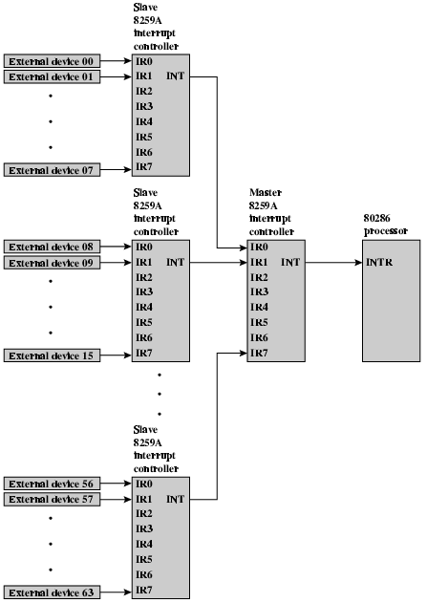
82C59A Interrupt
Controller

Slide 38
82C55A Programmable Peripheral Interface

Slide 39
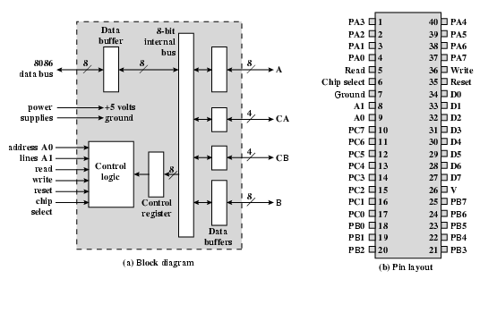
Intel 82C55A
Programmable Peripheral Interface

Slide 40
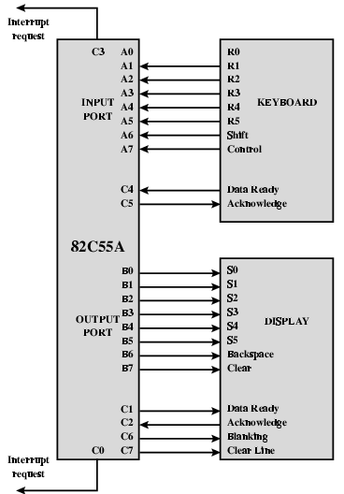
Using 82C55A To Control Keyboard/Display

Slide 41
Direct Memory Access
Interrupt driven and programmed I/O require active CPU intervention
  Transfer rate is limited
  CPU is tied up
Consider the case of moving a block of data
  Using programmed I/O, the CPU is dedicated to the task of I/O and can move data at a higher rate, at the cost of doing nothing
  Using interrupt I/O, free up to some extent at the expense of the I/O transfer rate
  Both methods have adverse impact on both CPU activity and I/O transfer rate
DMA is the answer

Slide 42
DMA Function
Additional Module (hardware) on system bus, as show in the next figure
DMA controller takes over from CPU for I/O
DMA module must use the bus only when the processor does not need it, or it must force the processor to suspend operation temporarily.
The last technique (above, in blue) is more common and is named as cycle stealing

Slide 43
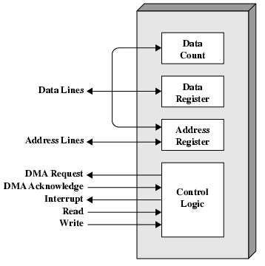
DMA Module Diagram

Slide 44
DMA Operation
CPU tells DMA controller:
  Read/Write
  Device address
  Starting address of memory block for data
  Amount of data to be transferred
CPU carries on with other work
DMA module deals with transfer (one word at a time), directly to or from memory, without going through the processor
DMA controller sends interrupt to the processor when finished
Thus, the processor is involved only twice, at the beginning and end of the transfer

Slide 45
DMA Transfer Cycle Stealing
DMA controller takes over bus for a cycle
Transfer of one word of data, at a time
Not an interrupt
  CPU does not switch context
CPU suspended just before it accesses bus
  i.e. before an operand or data fetch or a data write
Slows down CPU but not as much as CPU doing transfer, such as in Programmed I/O and Interrupt I/O

Slide 46
Aside
What effect does caching memory have on DMA?
Hint: how much are the system buses available?

Slide 47
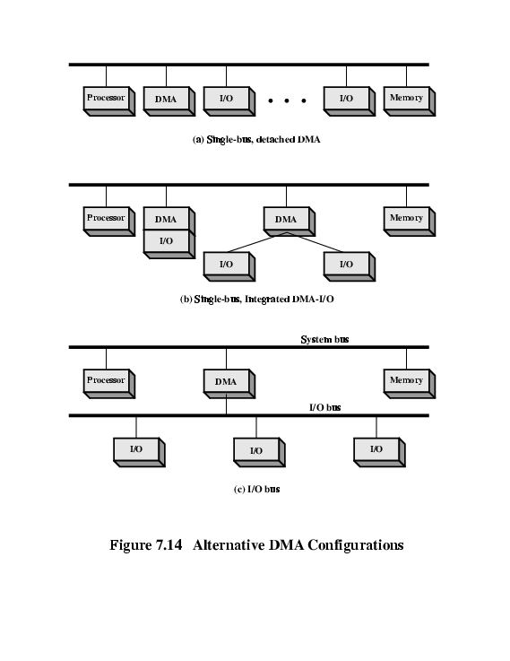
DMA Configurations (1)
Single Bus, Detached DMA controller
Each transfer uses bus twice
  I/O to DMA then DMA to memory
CPU is suspended twice (each transfer of a word consumes two bus cycles)
This configuration seems to be inexpensive, it is clearly inefficient

Slide 48
DMA Configurations (2)
— One or more I/O modules NOT included in the system bus
Single Bus, Integrated DMA controller. Thus, required bus cycles are much fewer
Controller may support >1 device
Each transfer uses bus once
  DMA to memory
CPU is suspended once

Slide 49
DMA Configurations (3)
Separate I/O Bus
Bus supports all DMA enabled devices
Each transfer uses bus once
  DMA to memory
CPU is suspended once

Slide 50
I/O Channels
I/O devices getting more sophisticated
Ability to execute I/O instructions. Thus, complete control over I/O operation
e.g. 3D graphics cards
CPU instructs I/O controller to do transfer
I/O controller does entire transfer
Improves speed
  Takes load off CPU
  Dedicated processor is faster

Slide 51
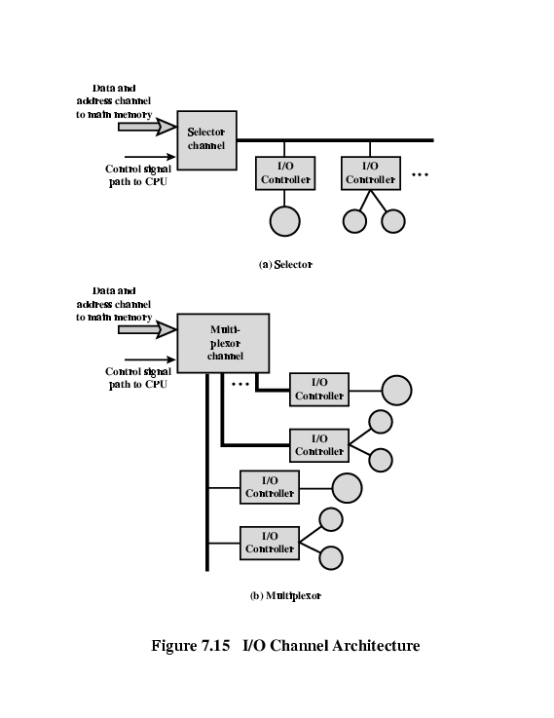
I/O Channel Architecture
Selector Channel
Multiplexor Channel

Slide 52
I/O Channel Architecture
Selector Channel
Controls multiple high speed devices
Any given time, it is dedicated to the transfer of data with one of those devices
Thus, I/O channel selects one device and effects the data transfer
Multiplexor Channel
Handle I/O with multiple devices at the same time
Low speed devices: a byte multiplexor accepts or transmits characters as fast as possible to multiple devices. E.g.,
A1A2A3A4,B1B2B3B4 and C1C2C3C4 can be A1B1C1A2C2A3B2C3A4
High speed devices, a block multiplexor interleaves blocks of data from several devices

